Slide 1
Notes:
Transition slide

Slide 2
In-Person Den Meeting Considerations
Den meetings are generally small enough to meet in person
Meeting rooms may need to be larger than normal to ensure spacing
Masks or dividers between Scouts
Gather enough supplies to eliminate sharing between Scouts
Notes:
Discuss at a high level how Den meetings lend themselves to in-person meetings due to their group size.
Simple safety considerations can make these in-person meetings possible if they can find a space to host them. Acknowledge that not every Den will have a space available to them.

Slide 3
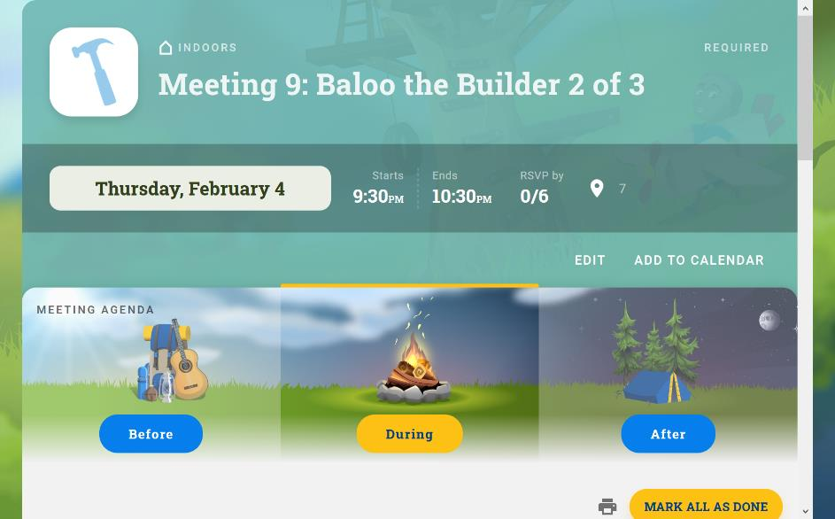
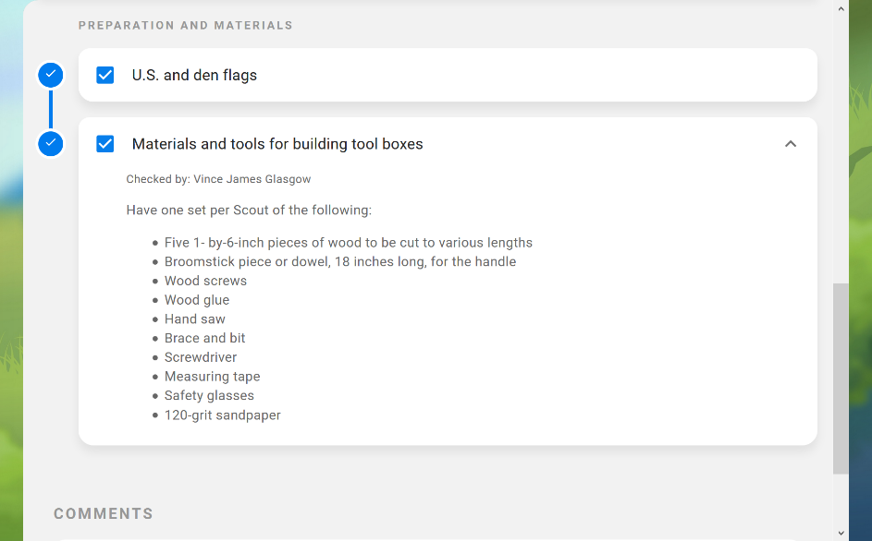
Den Leader Experience
Access to endless resources for Den Leaders
Den Leader Guidebooks
Cub Scout Songbook
Den Meeting Plans
Material lists
Activities
Pre-meeting games
Notes:
The Den Leader Experience is a new tool from Scoutbook. It is available to all registered Den Leaders.
Highlight the large number of resources included in the Den Leader Experience. There is a steep learning curve, but this tool can help Den Leaders plan their program, lay out den meetings, track attendance and participation, and communicate with parents. This tool has Den Meeting plans already loaded into it, including material lists, activity guides, games, and more. It is very robust.

Slide 4
Den Leader Guides
Den Meeting Plans for all Required & Elective Adventures
Plus Sections on:
How to deliver the Cub Scout Program
Understanding Advancement
How to Plan Den Meetings and Outings
Understanding Cub Scout age Children
Helpful hints
Notes:
Den Leader Guides are available for each age level, Lion – Webelos & Arrow of Light. These Guides are excellent resources with many sections. Most importantly, they include meeting plans for a full year of Den Meetings. A Den Leader can utilize these guides to lay out a full plan & calendar that makes achieving each rank possible for each Scout.
Guides are available on the Den Leader Experience, as print copies, and in the Kindle format.

